Slide 1
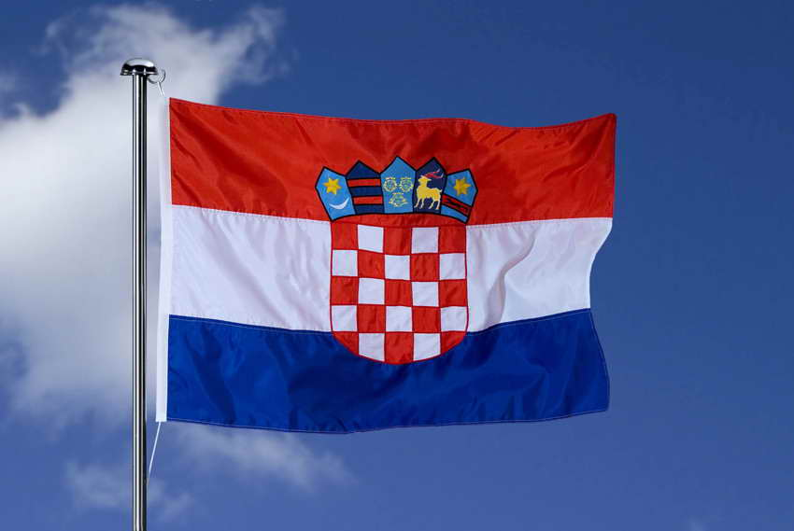
Lecture № 10
The quality assurance in higher education: the experience of the Republic of Croatia
Contents of the lecture reflects only the author's view, the Education, Audiovisual and Culture Executive Agency and the European Commission are not responsible for any use that may be made of the information it contains.

Slide 2
Plan
Legal principles of quality assurance in the Republic of Croatia.
The procedure for internal quality assurance of higher education in the Republic of Croatia.
The procedure for external quality assurance of higher education in the Republic of Croatia.
The activities of Quality Assurance Agencies in the Republic of Croatia.
The system of the quality assurance management of higher education in the Republic Croatia.

Slide 3
Croatia - peculiarities of development
Membership in the EU - from July 1, 2013.
Economic recession (-7%) in 2009
The unemployment rate is one of the largest in Europe.
Croatia is the ecological treasury of Europe (47% - land and 39% of the marine area - security zones).

Slide 4
Education in Croatia
Binary system of higher education
University education
Professional education
Based on programs of universities
Professional programs in polytechnic institutes and colleges of applied sciences

Slide 5
Factors that stimulated the education of Croatia
"Croatian National Educational Standard" Project of Programmes Modernization (2005);
Country Entry to the Bologna Convention (2009, Prague)
Reorientation of the educational system to the European standards;
Establishment the Agency for Science and Higher Education (ASHE, 2010);
Entry into the EU (2013).

Slide 6
Education in Croatia - the main facts
The level of education of the population 98,1%;
The right of citizens to education is enshrined in Article 65 of the current Constitution of the country;
In Croatia - 450 pre-school educational institutions;
In Croatia - 940 primary schools;
In Croatia there are 90 gymnasiums and 300 vocational schools;
In Croatia there are 8 state universities, 8 pedagogical, 7 polytechnic and 4 academies of art;
In total in Croatia - 145 000 students.

Slide 7
Croatian universities
University of Zadar (1396);
Osijek University;
Zagreb University (1669);
University of Pula;
University of Dubrovnik;
University of Split;
University of Rijeka;
International University of Dubrovnik

Slide 8
Trends in quality assurance in Croatia
Globalization of education;
Increase in the number of students and educational programs;
The emergence of new learning technologies, including distance learning (e-learning, MOOS and others);
The growing autonomy of universities and their openness for local communities and society as a whole.

Slide 9
Actual problems of quality assurance, explored by educators in Croatia
Quality assurance: determining the optimal degree of coverage in the context of the educational activities of the educational institution;
Quality assurance: motivation and mobilization of interested internal and external parties / participants;
Quality assurance: ensuring long-term impact on implementation;
Quality assurance as a transnational process.

Slide 10
thank you
for attention!
Contents of the lecture reflects only the author's view, the Education, Audiovisual and Culture Executive Agency and the European Commission are not responsible for any use that may be made of the information it contains.

