Slide 1
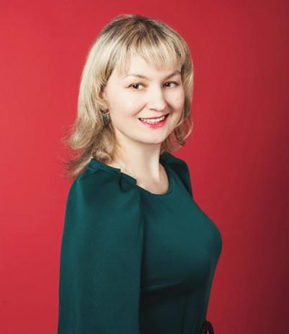
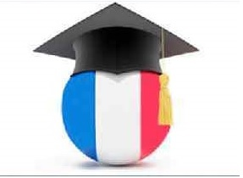
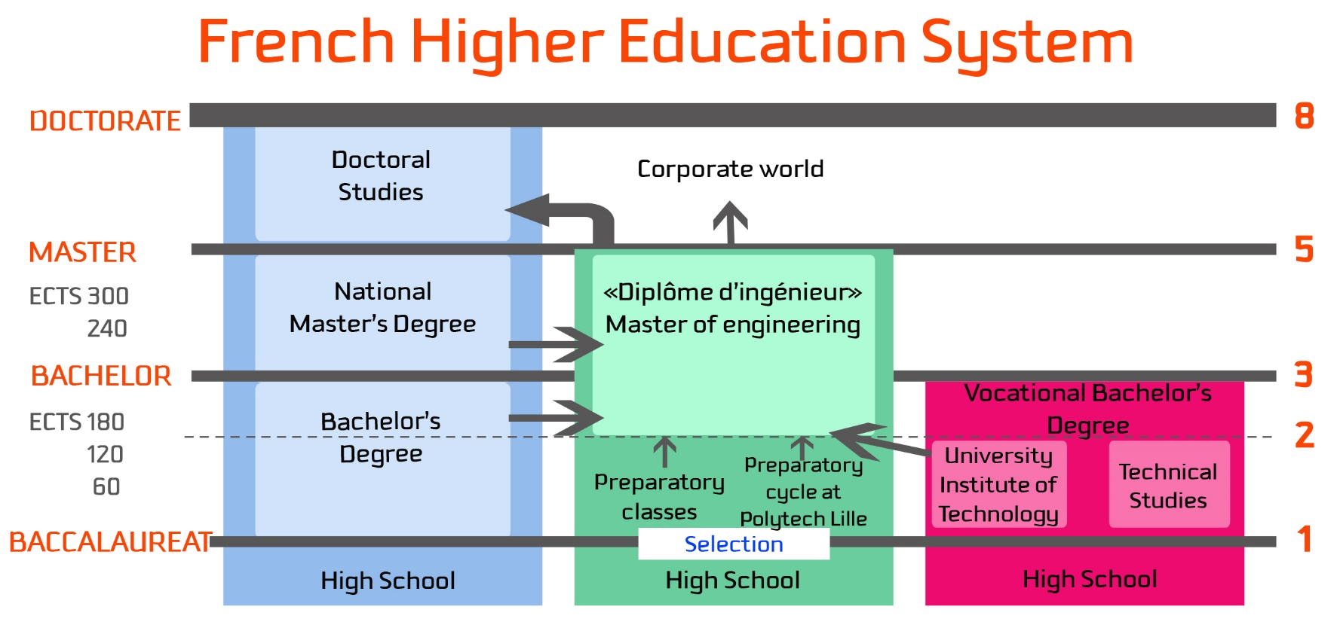
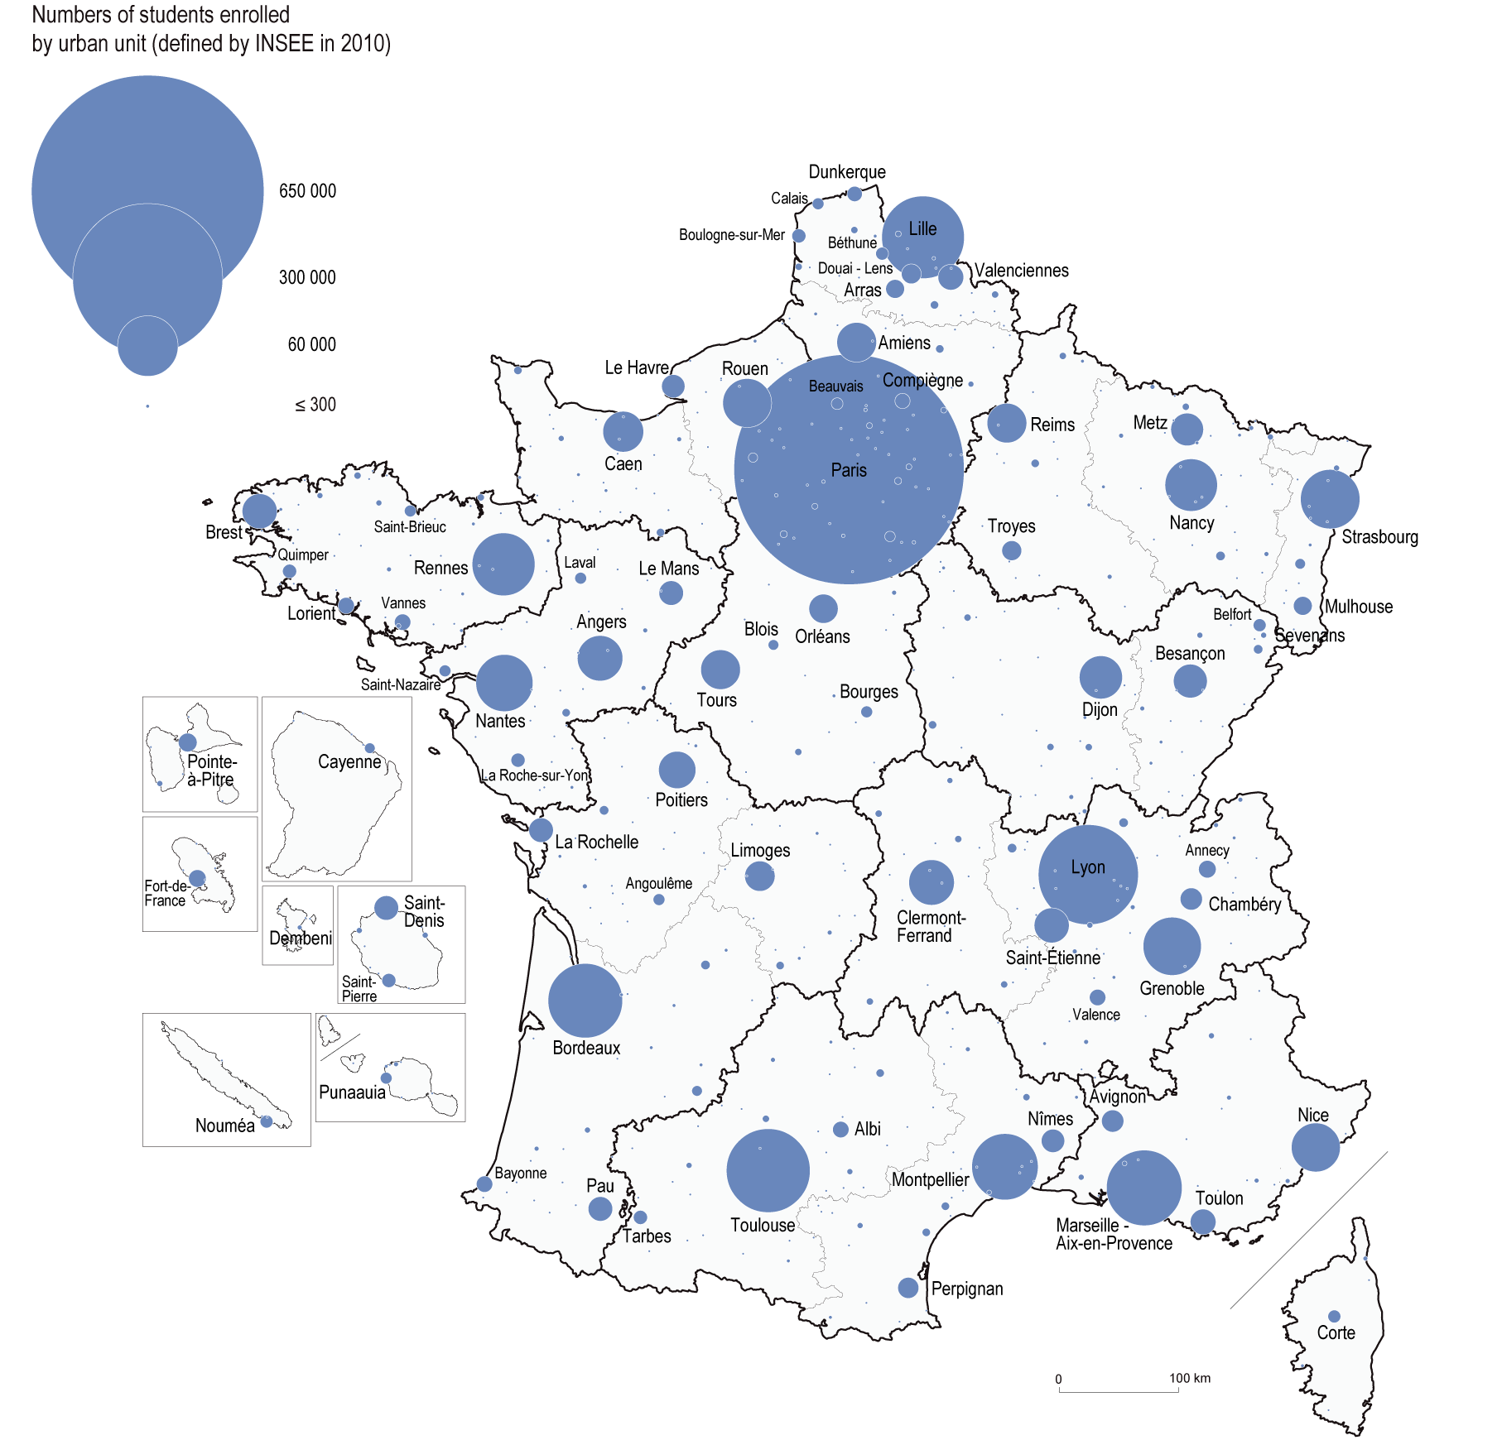
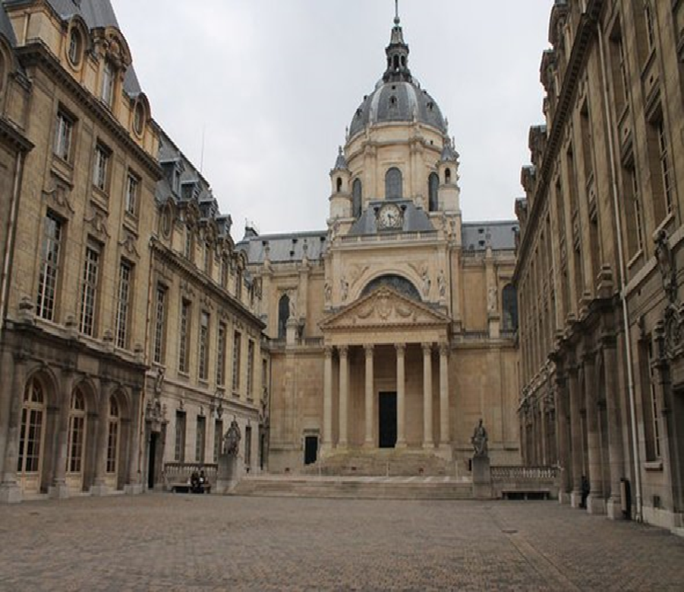
BORIS GRINCHENKO KYIV UNIVERSITY
France’s higher education:
the current state of development
Alla Durdas, Post-Graduate Student of the Department of Theory and History of Pedagogy
The relevance of the study. The modern higher education system fully meeting the requirements of the time is one of the key factors in the growth of the human capital quality, the generator of new ideas, the clue to the dynamic development of the economy and society as a whole. To perform these important tasks efficiently Ukrainian higher education needs to be updated in step with current global trends in development of education in a broader socio-economic context. The best practices and experience of France’s higher educational institutions can be used in the process of reforming the system of higher education in Ukraine on its way to the European integration.
Purpose of the study is to find out the current state of development of France’s higher education and to determine the current trends in it.
Methods of the study. The following general scientific methods were used to solve the stated problem: 1) analysis and synthesis method 2) scientific abstraction, induction and deduction 3) abstract-logical (for theoretical generalization of research results and conclusions).
Statement of the main material. The French higher education system is presently undergoing one of the deepest transformations of its history. In the last few years, several major pieces of legislation, partly unconnected, have triggered a process of change that will alter the structure of the system, the relations among its various components as well as their internal organization. Since year 2014 stabilisation of expenditure on higher education has been observed after a long period of high growth. In 2014, the French nation spent €29.2 billion on higher education, an increase of 0.3% in comparison with 2013. Expenditure on higher education has more than doubled since 1980, increasing by an average of 2.8% a year. In 2014, average expenditure per student in higher education totalled €11,560, 40% more than in 1980. The population of France has grown from 40 million inhabitants in 1940 to 67 million in 2017. The expansion of a mostly public system of higher education and research was supported by the booming wealth of its economy. With a GDP per capita of about 42,500 USD in 2017, it is nowadays ranked close to the two oldest developed countries in Western Europe, Germany (46,300USD), and the UK (41,800 USD). Students left school on average when they were 15.2 years old in 1965 and 21.7 in 2006. In 2012, 43% of the groups leaving education had obtained a higher education degree. The growth of the academic staff number in public higher education institutions has followed the growth of the student population, reaching 91,000 scholars in 2013. Staffing costs accounted for more than two thirds of expenditure on higher education. The French government provides the majority of funding for higher education, accounting for around 70% of financing in 2014, while households contributed just under 9%. At the start of the 2014-15 academic year, 680,000 students benefited from direct financial aid in the form of grants or loans. Financial and social support for students, including accommodation subsidies and forms of tax relief, totalled €6.0 billion. Today in France higher education is becoming more widely accessible.
This increase has been observed among students from all social backgrounds. In addition, more than half of students (55%) are women. Women make up the vast majority (70%) of those studying Arts or Human Sciences subjects, as well as paramedical and social care courses (84%). However, they still account for only a very small proportion of students on Science courses. In 2014-15, just over a quarter of students (27%) at engineering schools were women. The proportion of women doing apprenticeships is also low (39%).
Half of all women who left initial education between 2011 and 2013 had obtained a higher education qualification, compared to only 39% of men. Women with higher education qualifications are more likely to hold a baccalauréat + 5 years-level university qualification. Men are more likely to obtain qualifications from specialist schools and short vocational courses (BTS or DUT). The labour market is still less favourable for women and their access to employment is slower. They are less likely to have permanent employment contracts and more likely to work part time. Persons leaving higher education enjoy more favourable conditions in accessing the labour market than other applicants, particularly in times of crisis. Over the past 20 years, the number of women working as teacher-researchers has increased. In 2014-15, women held 43.9% of all lecturing positions, but still only accounted for 23.2% of university professors.
Conclusions. French higher education has risen as a result of a growing population and increasing needs of qualiﬁed man-power for the labour market. In France the state plays a key role in funding of higher education that has positive influence on its quality and accessibility. The growth of the number of students led to the growth of the academic staff number in public higher education institutions. In a difficult economic context, a higher education qualification remains an advantage in getting a job and pursuing a career.

