Slide 1
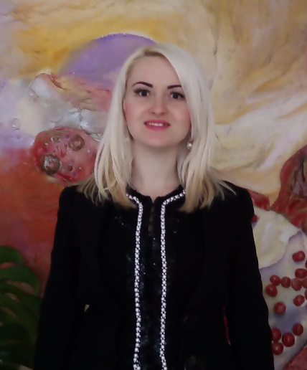
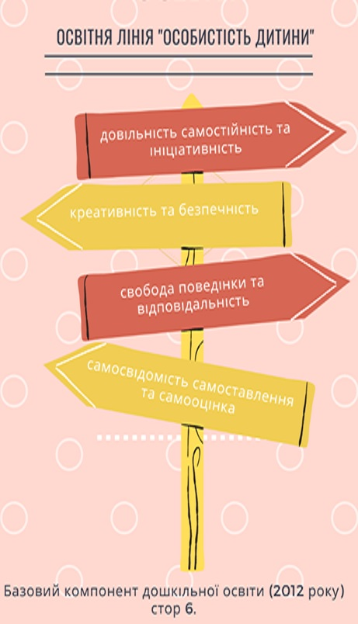
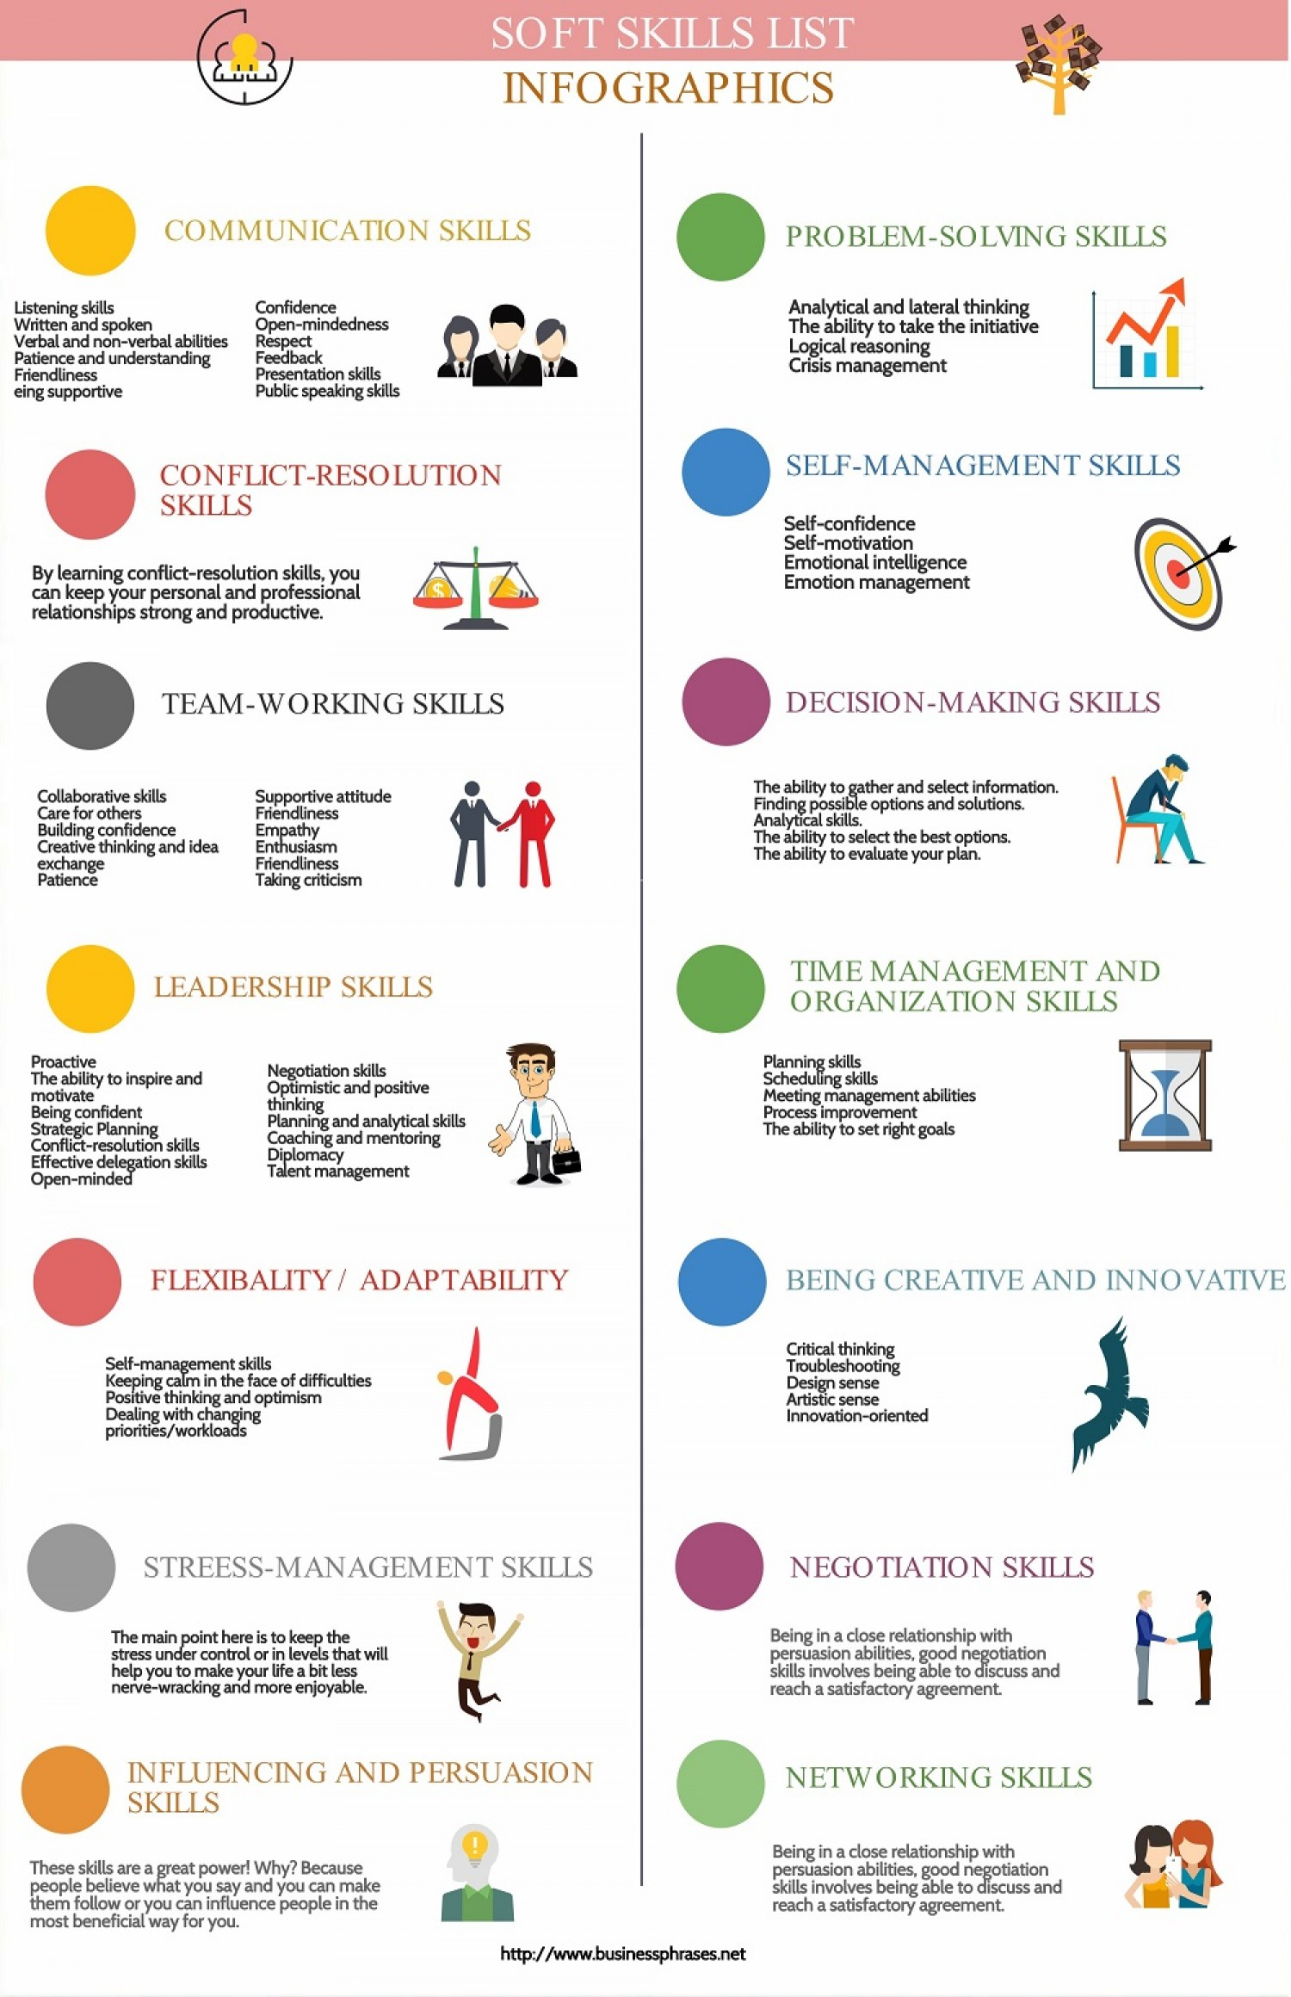
Quality of pre-school education in the countries of the Bologna Process: experience for Ukraine
Anna Ukhtomska, post-graduate student of the 2nd year of study, specialty "012 Preschool Education"
The quality of pre-school education in the countries participating in the Bologna process is considered from the perspective of soft skills: communicative, team-working, leadership and others. It has been emphasized that the most common preschool education systems in the EU countries are Waldorf education and Montessori education.
Relevance of research. Worldwide processes of globalization and internationalization require from modern professionals skills rapid collection, analysis and processing of scientific information on the short term, also social skills such as the ability to communicate effectively, creative thinking, teamwork, ability to work under pressure, ability to quickly adapt to new conditions. Most scientists insist that the earlier you develop skills, the easier the process. Preschool childhood plays a special, unique, peculiar role in the formation of personality. This age is sensitive to the formation of the primary syncretic worldview, the establishment of subordination of behavioral motives, arbitrary behavior, internal ethical instances of self-consciousness, laying the foundations of esthetic worldview and socio-cultural formation of personality.
Therefore, the formation of social skills should be taken care of during preschool childhood. The standard of preschool education of Ukraine in the line "Personality of the child" determines the level of expected competence of the child at the end of preschool childhood. The list of basic personality traits includes: arbitrariness, independence and responsibility, creativity, initiative, freedom of behavior and security, self-awareness, self-attitude.
The formation of the basic qualities of the child’s personality is relevant in each country participating in the Bologna Process. For Ukraine, the opinion of the scientific community on the diversity of forms and methods of working with preschool children is useful, because such research is an investment aimed at perfection and improving education, economy, positive changes in the lives of our citizens and development in various fields.
The purpose of the study: to investigate and compare the quality of preschool education in the countries participating in the Bologna Process.
Presenting main material. Each country participating in the Bologna Process has its own differences in preschool education systems. Together, there are some common system as Waldorf education and Maria Montessori system. It should be noted that the above pedagogical systems of education are very popular in each country participating in the Bologna Process.
Such kindergartens are very common in Germany. A feature of preschool education in Germany is a flexible schedule. Parents themselves can choose the number of hours the child spends in kindergarten. It would be useful for Ukraine to be able to choose a menu for their child in advance, because each child has their own individual taste preferences. A feature and unusualness for Ukrainian preschool education are male educators. I would be delighted if my children had a male educator, because such basic personality traits as self-assessment and self-esteem in girls would be easier to form. And for boys, of course, it is easy to draw courage, responsibility and confidence from a man's tutor.
Education in Denmark adheres to the principle of "Learning for Life". Danes believe that learning should fully develop the personality and not to turn man into a hostage of the system. Knowledge is for human, not human is for knowledge. That is why education in Denmark is more focused on practical training than theoretical. In Denmark, too, a significant proportion of pre-school staff are men.
Preschool education in Sweden focuses on the general development of children: progress is not assessed on special scales and levels. Particular attention is paid to the collectivization of children, also instilling respect for all others. All children spend a lot of time outdoors, regardless of weather conditions. Similar preschool education in Norway. In my opinion, it would also be useful in Ukrainian preschools to focus on health measures.
Preschool education in Switzerland is considered one of the best in Europe due to its traditions, quality of teaching and history of secondary schools. There are many followers of Maria Montessori and of Rudolf Steiner (founder of Walfdor pedagogy), Johann Pestalozzi and other famous teachers. German cantons pay attention to the general development of children, and Franco-Italian – to prepare the child for further education in schools.
Preschool education in Italy has been using the classic Maria Montessori system for over 100 years. In the kindergarten, all groups are of different ages. At the same time in the group of children 3-6 years, but the same percentage of older and younger children is maintained, so children develop mutual assistance skills, older people take care of younger ones, thereby increasing self-esteem and responsibility. The key environmental principle is the availability of all didactic materials in only one copy, which causes children to communicate and develop skills to negotiate. Freedom of choice of material forms such basic qualities as arbitrary behavior, safety and creativity.
Well-known graduates of Montessori institutions
Conclusions. Studying and analyzing the features and differences of preschool education systems, traditions, updating forms and methods of working with children significantly improves the quality of preschool education in Ukraine, which in turn significantly affects the quality of basic personality traits, children's readiness for school and reveals the potential of creative and harmonious personality.

