Slide 1
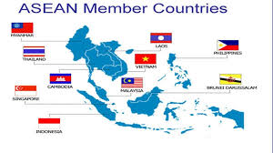
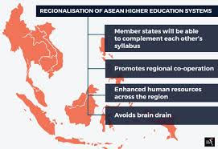
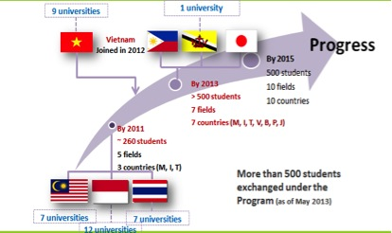
BORYS GRINCHENKO KYIV UNIVERSITY
THE INFLUENCE OF THE BOLOGNA PROCESS ON THE DEVELOPMENT OF HIGHER EDUCATION IN THE FAR EASTERN REGION
Oleksandra Nazarenko, post-graduate student of the 2nd year of study, specialty "Educational, pedagogical sciences"
Relevance of research. Today, during the time of integration and globalization processes, the focus on studying and borrowing the positive experiences of others is becoming more important. Education as a key indicator of the socio-economic level of societies plays an important role in building a successful, economically strong and independent country. Therefore, most countries of the world try to follow the example of the best, study their experience and implement it in own cultural realities. An example of successful imitation is the member countries of the Association of Southeast Asian Nations (ASEAN /АСЕАН), which, focusing on European colleagues, decided to reform higher education in the Far East region, to make it competitive and high quality.
The purpose of the study: to analyze the impact of transformations in the higher education sector of the European Union on the development of higher education in the Far Eastern countries.
Presentation of the main material. Today, when we talk about European education, we clearly understand that it is high quality, competitive, diverse and meets all world standards. Constant improvement of the legal framework, quality control of educational services, focus on increasing scientific knowledge, exchange of experience – all this has become a guarantee of a great image of European education.
Accordingly, the processes, which are expressed not only in quantitative but also in qualitative indicators, force other countries that are not part of the single European space to bring their education to the appropriate level. Following the example of Europe, the countries of Southeast Asia have begun to create their own unifying unions of international scale, aimed at the development of education.
One such organization represented in the Far East region is the Association of Southeast Asian Nations (АСЕАН), established in August 1967, which initially cared about economic development and the well-being of member countries. And only at the beginning of the XXI century, when the so-called Bologna Process began in Europe, it became clear that it is impossible to achieve striking economic results without taking into account the quality of education and the level of education of society as a whole.
One of the key areas of АСЕАН's work is cooperation in the higher education sector. With the results that Europe has achieved through the Bologna Process, the Association's policy in this area has largely focused on the implementation and monitoring by the institutional bodies in the АСЕАН system of various training and development activities and programs.
It should be noted that almost since the beginning of the Association, the leading countries have repeatedly raised issues of development and improvement of education in the South-Eastern region, focusing on European practices. At that time there was only an understanding of the direction in which the association will move, so the key in the field of education and science approved the following provisions:
• promote active cooperation and mutual assistance in matters of common interest in the economic, social, cultural, technical, scientific and administrative spheres;
• provide assistance to each other in the form of teaching and research tools in the educational, professional, technical and administrative spheres.
To date, АСЕАН member countries had achieved considerable achievements in higher education in the region, among which are the following: creation of АСЕАН University Network (ASEAN University Network (AUN)); approved and signed decision to convene a meeting of education ministers of member countries of АСЕАН on a regular basis and approved guidelines for regional cooperation in education.
The important points which can be traced to common action of all members of АСЕАН was that the association leaders stressed the importance of strengthening the identity and enhancement of human capital in education, which will lead to strengthening the university network.
The university network plays an important role in the development of higher education and science. Institutions (departments) have been established at the inter-university level, which plan and carry out work related to academic exchange, monitoring the quality of educational services, as well as promoting effective cooperation and dissemination of information among the network's universities.
Conclusions. In line with European practice, the governments of АСЕАН member states have concluded that in order to achieve significant progress in the socio-economic sphere, it is necessary to create their own space in which education will be a key tool to achieve these goals. To do this, first of all it is necessary to unify and adapt educational systems. Creating own model and concept for the development of higher education, which will be able to prepare for real life professionals of various profiles, focusing on the labor market – a priority for member states and their strategic partners.

