Slide 1
Report on the Module “Higher Education Quality and Its Expert Support: Ukraine's movement towards the European Union (ERASMUS+: Jean Monet)”
Sysoieva S.O.,
Project coordinator
(587094-EPP-1-2017-1-UA-EPPJMO-MODULE)
Contents of the article reflects only the author's view, the Education, Audiovisual and Culture Executive Agency and the European Commission are not responsible for any use that may be made of the information it contains.

Slide 2
Evaluation of the project proposal
Evaluation criteria | Mark | Max.
Relevance of the proposal | 22 | 25
Quality of the project team | 23 | 25
Quality of design and implementation | 22 | 25
Impact and dissemination | 20,5 | 25
Quality of the project team
3 EdD, professors;
2 EdD, associate professors;
1 PhD, associate professors;
2 researchers.

Slide 3
Aim
provide theoretical and practical training for PhD candidates on the quality assurance in higher education and its expert support in Ukraine, taking into account the EU countries experience
Tasks
1
Mastering PhD candidates with knowledge on the quality assurance in higher education and its expert support in the EU Member States
3
Mastering the technology of quality assurance export support in higher education by PhD students
4
Promoting the EU’s progressive experience in quality assurance in higher education and its expert support
2
Learning basic European standards and guidelines for quality assurance in higher education by PhD candidates
Implementation Date: September 2017 - August 2020

Slide 4
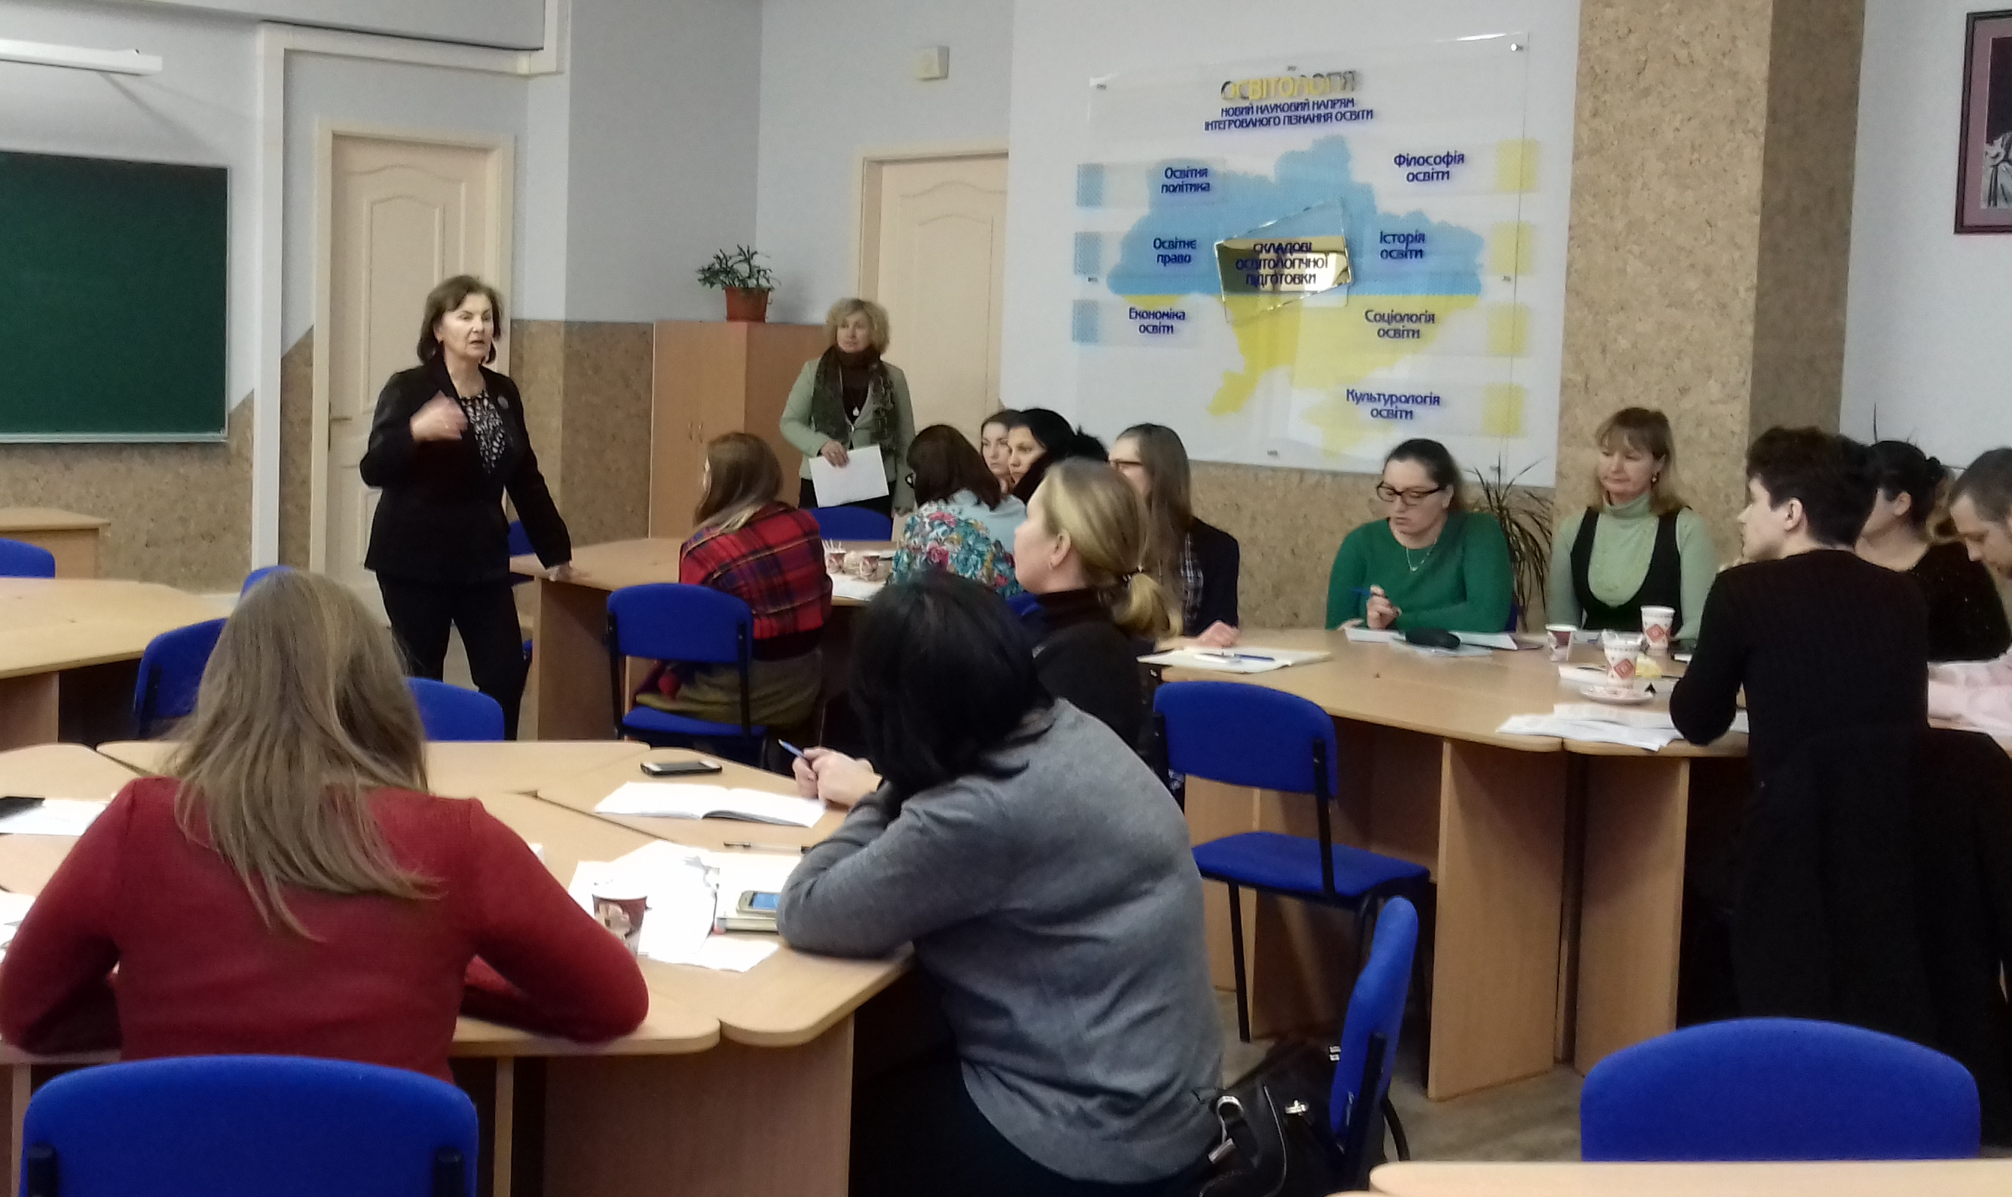
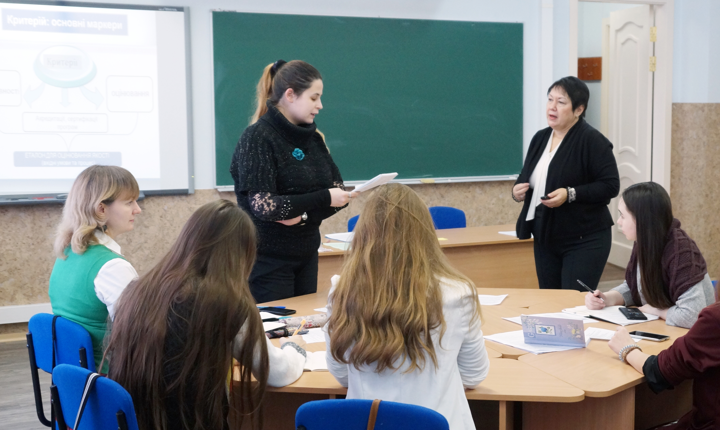
Results of project implementation
Planned | Results
 | 2017/2018 | 2018/2019 | 2019/2020
30 lections (60 h.) 30 seminars (60 h.) 11 trainings (44 h.) | 8 lections (16 h) 8 seminars (16 h) 7 trainings (28 h) | 12 lections (24 h) 12 seminars (24 h) | 10 lections (20h) 10 seminars (20) 4workshops 16h

Slide 5
Lection Topics
Quality assurance in higher education: the experience of the EU Member States:
Austria Belgium Bulgaria
Croatia Denmark Estonia
Finland France Germany
Greece Italy Hungary
Ireland Lithuania Netherland
Poland Portuguese Rumania
Slovenia Spain the UK

Slide 6
Training Topics
Criteria and performance indicators for an expert in quality assurance in higher education in the EU Member States
Accreditation expert activities
Methods and technologies of expert support of quality assurance in higher education in the EU Member States
Guidlines for quality assurance in higher education: the experience of the EU Member States
Accreditation procedure: experience of the EU Member States
Quality indicators of education in the EU Member States
Accreditation of educational programmes
Code of Ethics for Education Expert
Activities of higher education quality assurance agencies in the EU Member States
Expertise of innovation to ensure the quality assurance of higher education in the EU Member States
Comparative Research Methodology. Accreditation parameters of higher education systems, phenomenon, processes

Slide 7
Inclusion of new headings in open access scientific journals
 | Quality Assurance in Higher Education: Ukrainian-Polish Experience № 6, 2017 – 3 articles № 7, 2018 – 2 articles № 8, 2019 – 5 articles
 | Higher education quality and its expert support: the EU experience № 3-4, 2017 – 6 articles № 1-2, №3-4, 2018 – 6 articles № 1, 2, 3, 4, 2019 – 7 articles № 1, 2020 – 3 articles
 | The European Higher Education Area: current development vectors № 3, 2017 – 5 articles № 4, 2017 – 8 articles № 1-2, 2018 – 2 articles № 1-2, 2019 – 3 articles

Slide 8
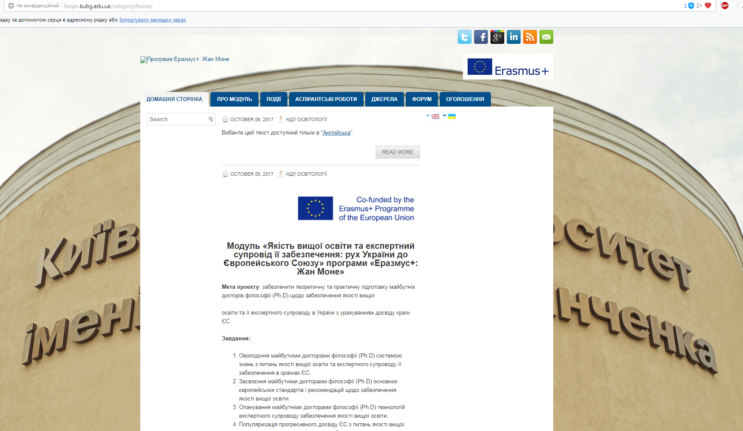
Creation and systematic filling of the website
http://heqes.kubg.edu.ua
While the site is functioning (Google Analytics results):
Users – 1 054;
Views – 5 027.

Slide 9
Questionnaire “Expectations from the discipline”
Priority topics selection by PhD students
Lection Topics | Seminar Topics
Expertise of innovation for quality assurance of higher education | Implementation of Higher Education Quality Assurance Standards: Ukrainian and European Experience
Standards and recommendations for quality assurance in higher education in the EU Member States | Managing the process of introducing educational innovations in the EU Member States
Methodology of quality assurance in higher education in the EU Member States | The concept of internal monitoring. Goal. Tasks. Toolkit
Leadership and functioning of educational systems to ensure quality assurance of higher education | Activities of international organizations in the field of comparative studies on education
Internal monitoring of quality assurance in higher education in the EU Member States | Legal and regulatory support for the quality of higher education in the EU and Ukraine

Slide 10
Study of the effectiveness of PhD students doing the module
(2017-2020)
Module learning performance was determined by descriptors that reflected:
Descriptors:
2 - the acquired knowledge corresponds to my expectations and professional interests, skills are formed at the basic level; fully satisfied with the content and organization of classes.
1 - the acquired knowledge partially meet my expectations and professional interests, some skills are formed at the basic level; partially satisfied with the content and organization of classes.
0 - it is difficult to assess the level of knowledge and skills generated; it is difficult to evaluate the content and organization of the lessons.
knowledge;
skills;
level of satisfaction with the content and organization of classes.

Slide 11
 | GENERAL DESCRIPTION OF THE RESULTS OF THE MODULE LEARNING EFFICIENCY | Descriptors
 |  | 2 | 1 | 0
 | Knowledge/ Understanding
1 | Theoretical questions on the subject | 70% (28 r) | 30% (12 r)
2 | Legal framework for quality assurance in higher education | 85% (34 r) | 15% (6 r)
3 | Principles for European standards and recommendations are based | 75% (30 r) | 25% (10 r)
4 | Basic principles of quality assurance of educational programmes | 85% (34 r) | 15% (6 r)
5 | European Standards and Recommendations for Internal Quality Assurance | 60% (24 r) | 40% (16 r)
6 | Internal (external) monitoring of the quality of higher education in the EU Member States | 65% (26 r) | 35% (14 r)
7 | Model and evaluation criteria for educational programs | 55% (22 r) | 45% (18 r)
8 | Quality criteria: evaluation of higher education institutions and programs | 65% (26 r) | 35% (14 r)

Slide 12
 | Competences | 2 | 1 | 0
9 | Identify and analyze major trends in quality assurance in higher education in Europe | 55% (22 r) | 40% (16 r) | 5% (2 r)
10 | Assess the European context of the external quality assurance system for higher education | 70% (28 r) | 30% (12 r)
11 | Interpret the basic principles of quality assurance in higher education in Europe | 85% (34 r) | 10% (4 r) | 5% (2 r)
12 | Consider quality principles as an integrated model of quality culture; distinguish between quality assurance and ratings | 50% (20 r) | 50% (20 r)
13 | Use licensing knowledge to critically analyze, evaluate, and synthesize a new set of ideas | 60% (24 r) | 40% (16 r)
14 | Use different research methods and information technologies in practical situations | 50% (20 r) | 50% (20 r)
15 | Participation in the work of multidisciplinary educational projects | 70% (28 r) | 30% (12 r)

Slide 13
Preparation and publication of scientific articles
1. Batechko, N. (2017). Higher education, quality of higher education, expert support and its assurance: the canonization of concepts (theoretical and methodological discourse). The Modern Higher Education Review, 2. P. 92–100.
2. Sysoieva, S. (2018). Comparative professional education in Ukraine: current state, challenges, prospects. Education: Modern Discourses. 1. Р. 43–54. DOI 10.32405/2617-3107-2018-1-5
3. Mospan, N. (2018). Quality Assurance Organizational and Management Structure in the European Union. Educological discourse, 1–2. P. 363–373.
4. Tryhub, I. (2018). Postgraduate extent of the education module «Higher Education Quality and Its Expert Support: Ukraine's movement towards the European Union». Continuing Professional Education: Theory and Practice, 1–2. P. 131–137.
5. Batechko, N. (2018). Conceptual bases of adaptation of Ukraine’s higher education to the standards of education quality of the European area. The Pedagogical Process: Theory and Practice, 1–2. P. 22–31.
6. Sysoieva S., Batechko N., Mospan N. (2018 ). Module Piloting for PhD Training: Experience of Ukraine. Journal of Modern Education Review, 8(9). P.661–666.
7. Локшина, О. (2018). Забезпечення якості вищої освіти в умовах європеїзації України. Неперервна професійна освіта: теорія і практика, 3–4. С. 127–132.
8. Batechko, N. (2019). The system of management of the university education quality: the experience of the European Union. Educological discourse, 3–4 (26–27). P. 342–357.

Slide 14
Управління проектом
Проблемні питання
Розширення аудиторії
Гнучкість змісту

