Slide 1


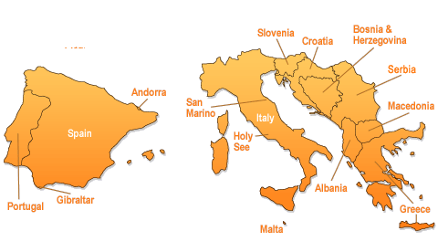






Synergetic model of quality assurance in higher education in the countries of Southern Europe
SOKOLOVA Iryna Volodymyrivna, Doctor of Pedagogical Sciences, Professor, Donetsk National Medical University (Mariupol)
The content of the lecture reflects only the opinion of the authors, the Executive Agency for Education, Audiovisual and Culture (EASEA) and the European Commission in the field of (higher) education are not responsible for the use of information contained therein.

Slide 2



WHY THE TOPIC IS CURRENT
Integration of Ukraine into the European system of quality assurance of higher education
Government member of the European Quality Assurance Register (EQAR) since 2008
"The quality assurance system operates throughout the country (Ukraine), but has not yet been fully aligned with ESG 2015"
The mission of the National Agency for Higher Education Quality Assurance is to become a catalyst for positive changes in higher education and the formation of a culture of its quality.
Partnership
innovation
integrity
openness
transparency
professionalism
trust
Ukraine's membership in European organizations
VALUES
EHEA countries YES
ENQA NO
ECA NO
EUA - YES 24 universities as individual or associate members (Borys Grinchenko Kyiv University)
ESU YES

Slide 3
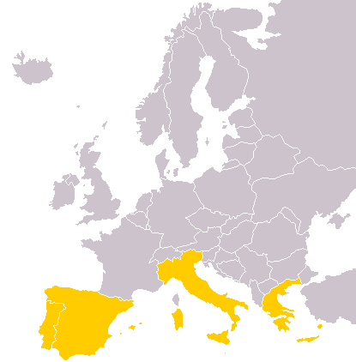






RESEARCH METHODOLOGY
Object of research
Research tasks
  activities of Agencies for Quality Assurance in Higher Education (HE) in the countries of Southern Europe (CSE)
What approaches, conditions, procedures for ensuring the quality of HE are common to CSE
What effective quality assurance practices at the level of national agencies can be recommended for implementation in Ukraine
Greece: Quality assurance and accreditation agency in higher education (ADIP)
Portugal: Agency for Assessment and Accreditation of Higher Education (A3ES)
Croatia: Agency for Science and Higher Education (ASHE)
Italy: The National agency for the evaluation of the university and research system (ANVUR)
Spain: National Agency for Quality Assessment and Accreditation
(ANECA)
the Slovenian Quality Assurance
Agency for Higher
Education (SQAA)
Methodological research platform:
systemic, synergetic, procedural-activity approaches

Slide 4

Why a synergetic approach? Synergism – the effect of interaction.
"Patterns of new thinking" (V. Kremen)
Evolution
Changes; adaptation to new conditions
Inviromental space
Social dynamics
Coherence
coordination of approaches, standards, processes, procedures
Logical conclusions based on the results of actions, consequences of events
Generalization, abstraction, transfer to a new (other) plane / space
Dissipation
Openness of the HE system
Multilevel internal organization
Constant updating environment
Transformations based on self-organization, self-development
Fluctuation
Alternative trends that are harmonized
Alternation of dominance: "embryos of a new state"
Patterns of higher education development (author's opinion)
Vision of the quality of higher education
Progressive ideas for quality assurance in higher education
Values (separated values)
Quality assurance standards for higher education
Samples of best practices (procedures, tools)
Attractors of "order"
Socio-political
socio-cultural
Bifurcation
Change settings
New standards: transition to a new order
Fig. 1 New quality: synergy of higher education development (author's idea)

Slide 5
QUALITY ASSURANCE (QA) IN HIGHER EDUCATION: KEY MILESTONES OF HISTORY
Principles of quality assurance in EHEA
2005
Quality Assurance Standards and Recommendations in the EHEA (ESG). Proposed by group E4 (ENQA, ESU, EUA, EURASHE
Higher education institutions are responsible for the quality of education and its provision
QA responds to the diversity of higher education systems, institutions, programs, and HE applicants
QA supports the development of a quality culture
QA takes into account users and the expectations of students, all other stakeholders and society
2006-2019
2008
2015
European Quality Assurance Forum (EQAF)
European Register for the Quality Assurance of Higher Education (EQAR)
ESG 2015 adopted. E4, EQAR, Education International and BUSINESSEUROPE groups proposed

Slide 6



Spain Population ; 46,218,000
university system : 84
Ranked universities 2020: 45
Greece Population :11,280,00
HEIs: 25
Ranked universities 2020: 10
Italy Population: 60,918,000
HEIs: 97 Ranked universities 2020: 52
Portugal Population 10,524,000
HEIs: 134 Ranked universities 2020: 13
Ukraine Population: 44, 622, 516
HEIs: 282 (університети, інститути) Ranked universities 2020: 6
Croatia Population: 4,089, 400
Slovenia Population: 2,067, 372
HEIs: 130 Ranked 2020: 2
HEIs: 92 Ranked universities 2020: 2
Data sources: The World Bank
Notes:
Вставьте карту своей страны.

Slide 7

A generally accepted and recognized landmark
General trends in quality assurance
Institutionalization in the field of quality assurance in higher education (defined levels of responsibility, agencies, management systems in the HEI)
Articulation of compliance with EU documents, national legislation, ERC, NRC, with ESG 2015 standards
Dynamics of changes in the organization, procedures, evaluation models
Integration into European and international quality assurance structures; educational and scientific collaboration
Adaptation, balanced combination of domestic experience and best world and European practices
Visualization of the activities of agencies at the international level and approval of messages on the formation of a culture of quality in the VO system; strengthening the responsibility of all stakeholders for quality assurance
The ESG 2015
Formation of a culture of quality, ensuring the educational needs and expectations of HE applicants, stakeholders, society
quality
assurance
quality improvement
mechanisms for quality assessment and accreditation as a means of consumer protection and providing information to "clients" of the higher education market.
!

Slide 8
COUNTRIES OF SOUTHERN EUROPE: GENERALIZED DIRECTIONS OF ACTIVITY OF NATIONAL AGENCIES
Quality management entities
Greece (ADIP)
Italy (ANVUR)
Spain (ANECA)
Croatia (ASHE)
Portugal (A3ES)
Slovenia (SQAA)
continuous improvement of training programs
introduction of a high quality dual system
розвитку міжнародного вимірі ВО
Quality of staff and social dimension of the student body
Effective financing of free economic zones
Development of quality culture
Contribute
Provide
Agency statuses: full members ENQA, registered on the European Quality Assurance Register for Higher Education (EQAR); CEENQA (Network of Central and Eastern European Quality Assurance Agencies in Higher Education), ECA (European Consortium for Accreditation)

Slide 9
COUNTRIES OF SOUTHERN EUROPE: GENERALIZED SYNERGETIC MODEL OF QUALITY ASSURANCE SYSTEM
Quality assurance system management levels
Synergy of quality assurance standards
Level 1 State (determines the legal framework, functions of agencies and line ministries)
Level 2 of the Agency for quality assurance, evaluation, accreditation with certain management entities
Level 3 Higher education institutions with specially formed structures: quality assurance departments, internal evaluation, evaluation centers, independent evaluation departments, etc.
Level 4 Stakeholders: combined student and faculty student committees, supervisory boards
Internal quality assurance•
External quality assurance•
Quality assurance agencies
Plan
Do
Check
Act
Procedures:
accreditation (primary, periodic) of study programs, HE institutions, transformations in HE institutions, transnational education
audit (internal quality assurance systems, external audit of HEI activities),
evaluation (thematic)
Quality assurance cycle

Slide 10






ECTS AS AN INDICATOR OF EXTERNAL EVALUATION OF THE QUALITY OF HIGHER EDUCATION: INDIVIDUAL ROUTES OF COUNTRIES
The name of the country ECTS elements | ECTS to determine learning outcomes and credit load | ECTS for the recognition and transfer of credits | Existence of credit recognition appeal procedures |  | Application of tables of statistical distribution of points | Application of documents that support ECTS
Greece | + | +
Croatia | + | + |  |  |  | +
Italy | + | + | + |  | + | +
Portugal | +
Slovenia | The ECTS Users Guide 2015 principles are NOT required to be used by external QA
Spain | + | +
EACEA National Policies Platform, 2020

Slide 11
Different cultural contexts, history and traditions; various HE systems, institutions, programs and applicants
Different levels of autonomy and power of HEI for IQA. Different QA models
Different levels of independence and QAA capacity for EQA
The results of quality assessment differ
Permission for educational activities / awarding degrees
Impact on the financing of HE institutions
Recommendations for improving the quality assurance system
Different types of agencies (European, national and regional agencies)
Different areas of activity: evaluation, audit, accreditation
Program level and / or institutional level
In a specific specialty / multidisciplinary \ double degree
Diversity of internal context and approaches to quality assurance: A COMMON strategic aim

Slide 12
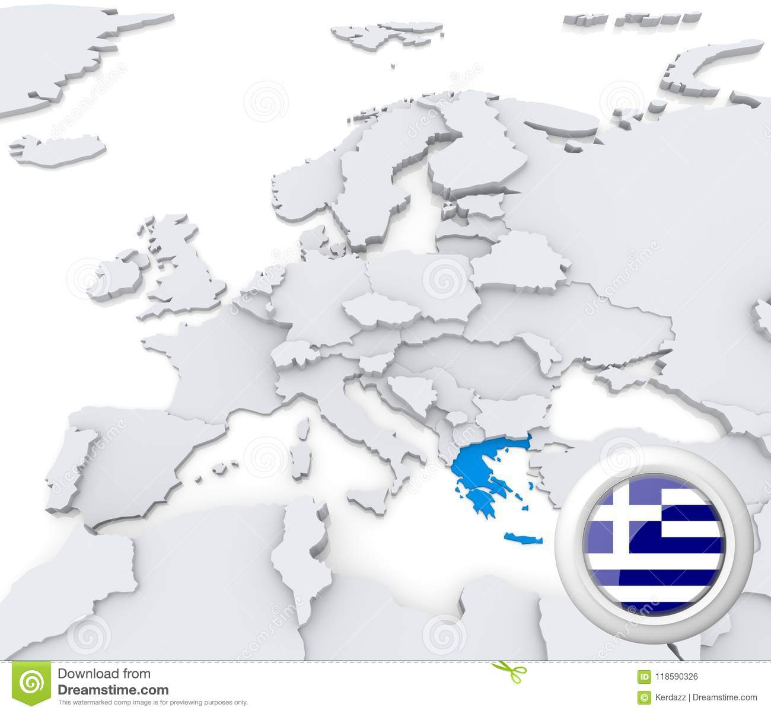
The Hellenic Republic. ADIP as a service center for quality assurance:
Administrative and organizational services to HEIs
Criteria for accreditation of the training program (TP)
Objective: to develop a unified framework program to ensure the quality of teaching and research in the HEI
academic nature and orientation of TP
learning outcomes and expected qualifications according to the NQF
structure and organization of TP
quality and efficiency of training
compliance with the qualifications of teachers
quality of scientific research
the degree of interrelationship between teaching and research
quality of training and research support services
demand in the labor market for the acquired qualification
Areas of responsibility: definition, organization, implementation, specialization and standardization of principles, criteria and indicators; methodology and procedures of accreditation (ZVO, training programs); coordination and support
Notes:
Вставьте изображение какого-либо географического объекта вашей страны.

Slide 13
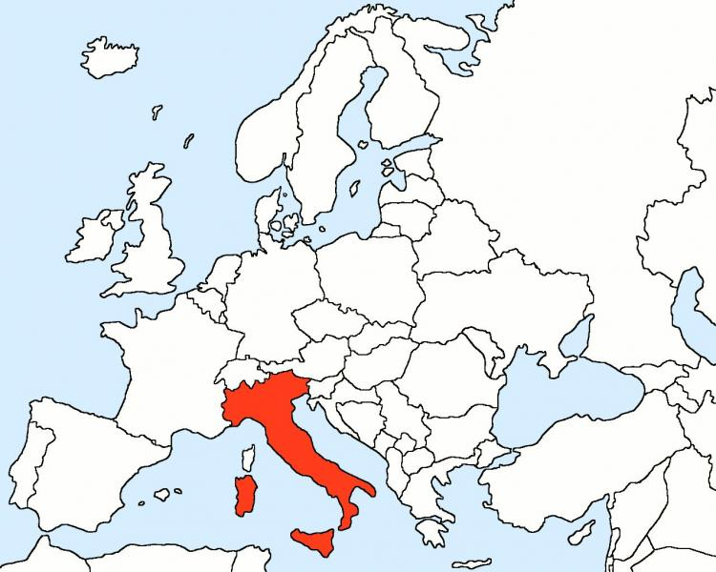

Republic of Italy. The AVA system (Autovalutazione, Valutazione periodica, Accreditamento) Self-assessment, Periodic Evaluation, Accreditation
NdV
Conducts accreditation procedures (institutional and program)
Composition: 6 people, mostly from other free economic zones
Mandate: for 4 years
Ensure confidence that HEIs provide quality services
assure that HEIs are responsible for the use of public resources
improve the quality of teaching and scientific research
CdA
PQA
CPDS
Functions
Expresses an opinion on compliance with the conditions of the primary accreditation in order to create new training programs;
Verification of the functioning of the CSF
Support to the administration of HEI and ANVUR in conducting continuous monitoring of certain indicators of quality assessment
The main tasks of the actors
CdA - Institutional Strategic Board of Directors
PQA - Executive body for internal quality assurance
CPDS - Groups for ensuring the internal quality of training programs
NdV - Independent internal and external quality assessment department

Slide 14

Republic of Croatia: external quality assurance procedures (audit)
Quality assurance cycle
PDCA (Plan-Do-Check-Act).
Indicators
Audit of a higher education institution (faculty)
Aim
evaluate the effectiveness of the internal quality assurance system of the HEI or the faculty on the basis of ESG 2015 by levels: initial, development, improvement
Quality policy
Planning and management
Implementation and monitoring
Rating
Improving innovation, impact
1) Planning
2) Site visit (Site visit (interview with stakeholders, collection and analysis of evidence base, information)
3) Report (with recommendations)
4)Follow-up: HEI – prepares a 2-year action plan; 6 months support of the ASHE coordinator, examination
Notes:
Вставьте изображение времени года в вашей стране.

Slide 15
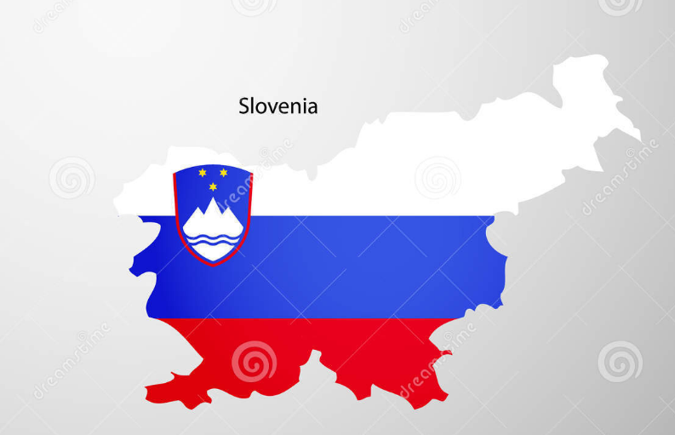
Republic of Slovenia: experience of international quality assurance activities
Membership in international organizations: EQAR, ECA, ENQA, CEENQA, INQAAHE
Participation in international projects
Transnational higher education (THE)
JOQAR
Accreditation and recognition of joint training programs
MULTRA
Mutual recognition of accreditation results for joint programs
CeQuInt
Quality certification of internationalization
Monitoring the activities of free economic zones in the field of THE
Determines the criteria and conditions for the implementation of THE
EEEP – ECA Expert Exchange Platform
Creating a profile platform for experienced experts
Qrossroads
Recognition of qualifications provided by other HEIs
Regulates the validation and recognition of THEs in the Republic of Slovenia
Notes:
Вставьте изображение животного или растения в вашей стране.

Slide 16
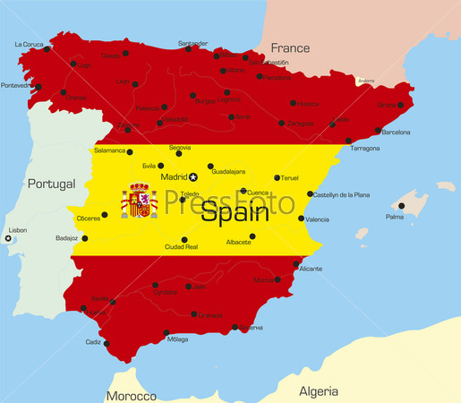

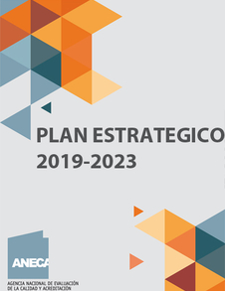
The Kingdom of Spain: academic staff evaluation
Recruitment program for mandatory evaluation of academic and scientific activities of applicants for the positions of PhD assistant lecturers, PhD lecturers in public or private universities.
Academic Staff Evaluation Procedure
Programme Evaluation Procedure
Institutional Evaluation Procedure
Program for assessing the competence and qualities of applicants for the positions of Senior Lecturer, Professor, which belong to the category of civil servants.
The National Research Evaluation Committee (CNEAI) conducts a process to evaluate the research activities of university professors and researchers at the Spanish Higher Scientific Council (CSIC) so that they can receive a supplement to the wages for productive activities.
• expanding the Agency's international presence
• strengthening external communication, coverage of the media and society with objective information in order to build trust
• improving internal communication, which provides useful and cross-cutting information for different departments
• strengthening the ANECA team by promoting its development, motivation and efficiency

Slide 17
PORTUGAL: EXPERIENCE OF ACCREDITATION OF CURRENT TRAINING PROGRAMS
Focus on processes that are considered critical for quality assurance and on monitoring methodologies to improve the quality of curricula and research programs
General characteristics of the curriculum
1.5. Publication of the curriculum in the Official Journal.
• 1.6. The main scientific direction of the training program.
• Learning outcomes
6.1. Academic success.
6.2. Employment.
Student-oriented teaching methods and teaching
• 2.1. Adequacy of teaching and learning methods.
• 2.2. Adequacy of student workload.
• 2.3. Adequacy of student assessment methods.
• Internationalization.
8.1. Mobility of students and teachers.
8.2. International students study.
8.3. Participation in international networks.
Demand for the training program for the last 3 years
Specific evaluation parameters and criteria

Slide 18
Conclusions
Institutionalization of national quality management systems: synergy of actions
Internationalization of agencies activities: synergy of partnership
Harmonization of standards, procedures, indicators: synergy of innovative processes
Orientation of the countries of Southern Europe on formation of culture of quality by introduction at all levels of management of higher education
Values
Quality planning (smart purposes)
Quality assurance (adapted procedures, flexible criteria)
Quality control to achieve perfection
Perfect
aim-quality
Quality management
Professionalism
Trust
Evidence
Impartiality
Transparency
Integrity
Partnership
Notes:
Вставьте изображение интересного для туристов места в вашей стране.

Slide 19


Thank you for attention!
Questions
Comments

